Slide 1
Jamuna Multipurpose Bridge Bangladesh, 1972 – 1998 GENG5505 Project Management and Engineering Practice Group 6 – Wednesday 2pm

Slide 2
SECTION A
PROJECT BACKGROUND
This section provides an overview of the Jamuna Bridge in Bangladesh as well as related management issues and recommendations mentioned in this report

Slide 3
Shehab Section

Slide 4
Ravanjot Section

Slide 5
SECTION B
PROJECT ANALYSIS
This section will analyse in detail the management issues related to Jamuna Bridge in Bangladesh

Slide 6
Eden Section

Slide 7
Ye Section

Slide 8
Issues in Execution Stage and Finalization Stage of the Jamuna Bridge
Ye li 24427082
-Construction challenges​
-Supply and management of resources
-Management of structural maintenance of bridges
-Environmental and social impacts​

Slide 9
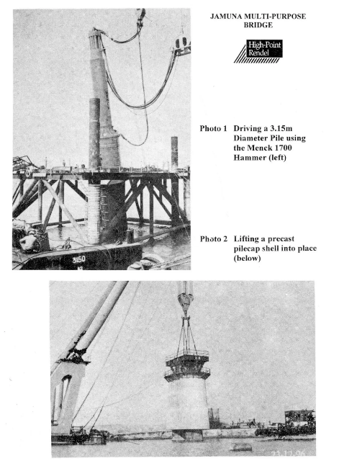
Construction Challenges
Ye li 24427082
Execution stage
- Challenges due to changing river morphology
- Impact of special climatic conditions
- Need to build complex structures (guide dams, rockfall berms, etc.)
Image Source: [https://www.slideshare.net/slideshow/foundation-of-jamuna-bridge-method-construction/265917512#15]

Slide 10
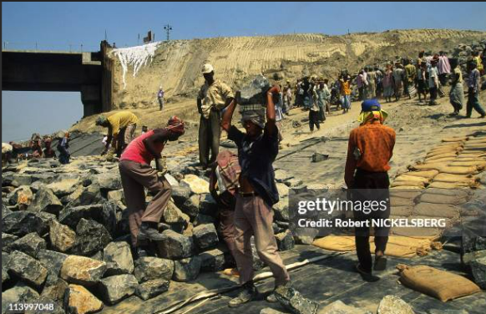
Supply and Management of Resources
Ye li 24427082
Execution stage
- Difficulties in transporting materials and equipment (sea transport limitations, climate impact)
- Labor shortages and training needs
Image Source: [26,041 Jamuna Bridge Stock Photos, High-Res Pictures, and Images - Getty Images | Jk bridge]

Slide 11
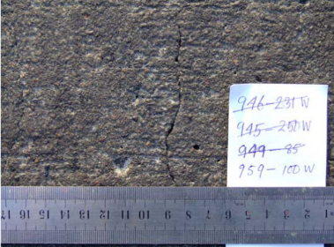
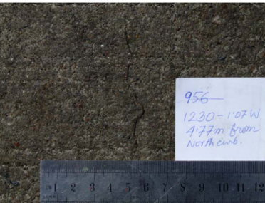
Management of Structural Maintenance of Bridges
Ye li 24427082
Finalization stage
- Cracks in bridge structures (causes and management)
- Importance of maintenance management
Image Source: [(PDF) Cracks in the box girders of Bongobondhu Jamuna Multipurpose Bridge- Identification of causes based on FE analysis (researchgate.net)]

Slide 12
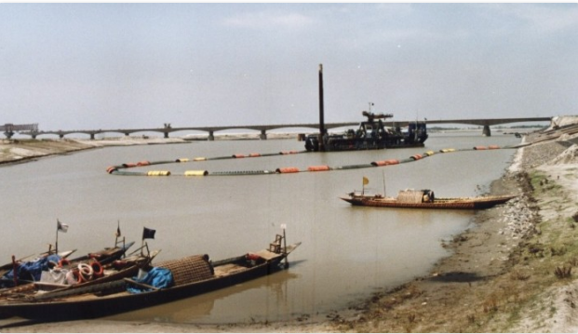
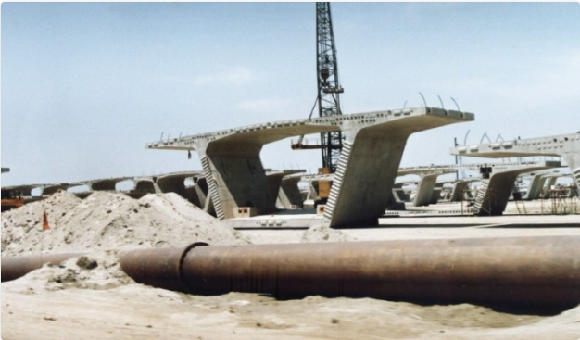
Environmental and Social Impacts
Ye li 24427082
Finalization stage
- Impact on local ecosystems and biodiversity
- Socioeconomic impacts (unemployment, relocation, changes in education and health services)
Image Source: [Jamuna Multipurpose Bridge | Huckbody Environmental Ltd]

Slide 13
SECTION C
RECOMMENDATION
This section will address the issues identified in Section B of the Jamuna Bridge project in Bangladesh and provide management recommendations

Slide 14
Zhulin Section

Slide 15





SECTION C
RISK MANAGEMENT
Polluting the local environment
Resettlement the Char people
Managing the workforce
Risk Event
River regulation works
Quality of construction

Slide 16
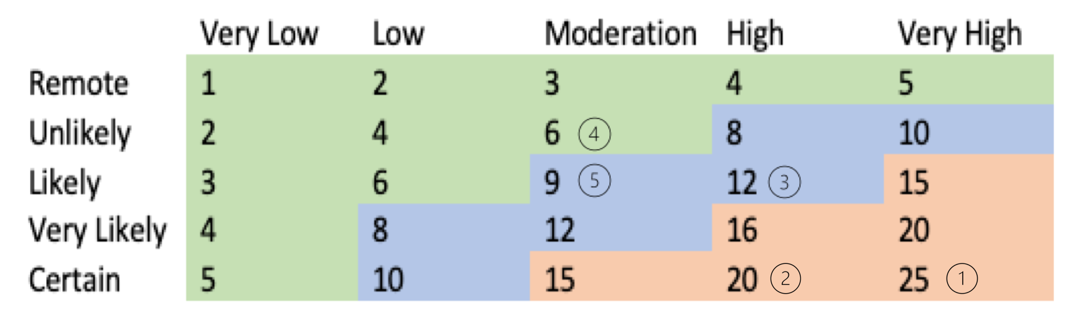
5 by 5 priority grid
SECTION C
RISK MANAGEMENT
Risk Registers
Risk Event | Probability | Impact | Priority | Responsibility | Strategy | Review
1. Resettlement the Char people | Certain | Very High | 25 | Very High | Action Now | Weekly
2. River regulation works | Certain | High | 20 | Moderation | Plan Action | Monthly
3. Quality of construction | Likely | High | 12 | Moderation | Plan Action | Monthly
4. Managing the workforce | Unlikely | Moderation | 6 | High | Plan Action | Monthly
5. Polluting the local environment | Likely | Moderation | 9 | Moderation | Do Nothing | Half Year

Slide 17
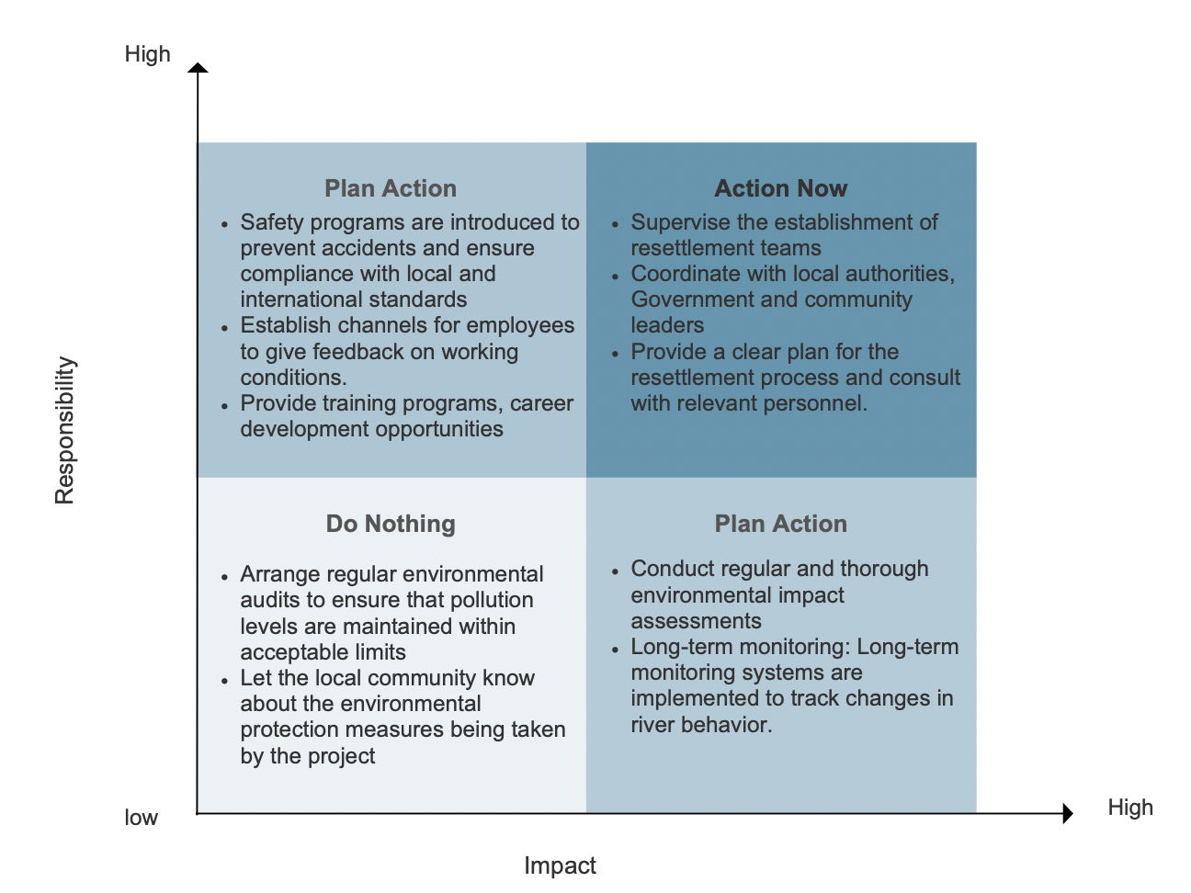
Risk-Response Matrix
Notes:
A systematic risk register was used to track these risks, prioritizing them using a 5x5 grid of probability and impac

Slide 18
SECTION C
RISK MANAGEMENT
Managing Conflict Risks of Interests
Establishing an Inspection Panel: This panel would be responsible for identifying and addressing the needs and placement of the Char people at the processing of the project
Holding Regular Risk Review Meetings: This proactive approach ensures that identified risks are effectively managed and that new risks are promptly addressed, preventing major disruptions to the project.
Other Risk Management
Safety risk
Environmental Risks
Regulatory and Legal Risk
Project Management Risk

Slide 19
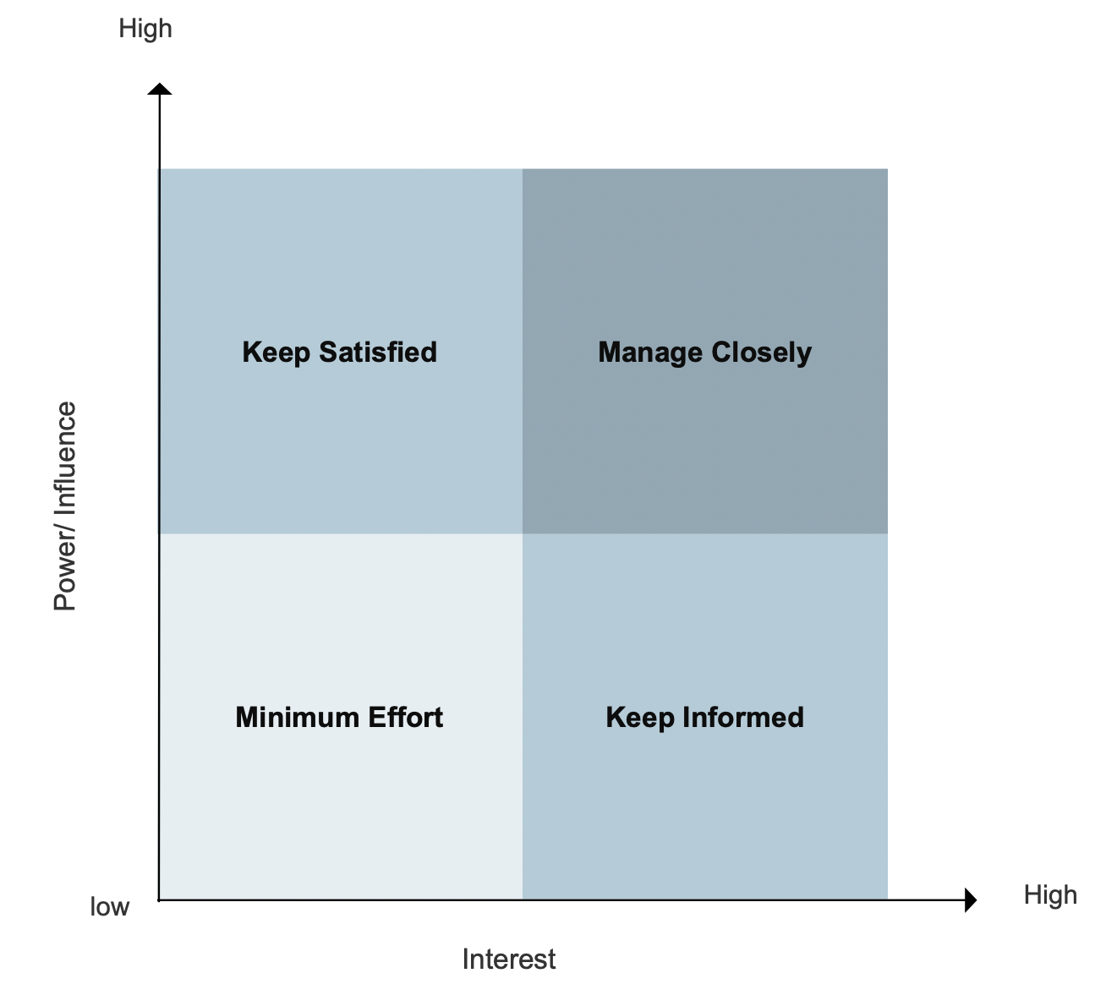
SECTION C
SKATEHODER MANAGEMENT
Stakeholder Power and Interests Matrix
Local Political Leaders
Government Authorities
Project Sponsor
Financial Institutions (the World Bank)
Environmental NGOs
General Public
Char People
Suppliers/Subcontractors
Media

Slide 20
SECTION C
SKATEHODER MANAGEMENT
Participate: During the project planning phase, the project manager and team members should be designated as participants responsible for developing the project plan.
Signoff: The roles of stakeholders who will provide final acceptance and sign-off on the Project's key deliverables should be clearly defined. This ensures that the results of each major phase are formally acknowledged, with a client representative signing off on the final acceptance document upon Project completion.
P
PARIS Framework
Approve: The Project sponsor or executives should be responsible for approving key aspects such as budget approvals and critical milestones, ensuring that the Project aligns with organisational goals.
S
A
I
R
Inform: The Project clients and external stakeholders should receive regular progress reports to keep them informed of the Project's status and any changes that may impact them.
Responsible: The Project manager should be responsible for communicating with the Char people, ensuring that their resettlement is carried out according to the plan, and
addressing any concerns that may arise during the process.

Slide 21
SECTION C
SKATEHODER MANAGEMENT
Information Management System
Placement Personnel Database
This system would compile and record detailed information on all affected residents, allowing the Project team to develop fair and transparent compensation and resettlement plans. The system should also track the progress of resettlement activities, ensuring that all commitments are fulfilled and that any issues are promptly addressed. This approach not only helps to mitigate social risks but also fosters trust and cooperation between the Project team and the affected communities.
Procurement Management System
This system would provide effective control over people of the supply chain, ensuring that accountability is
maintained throughout the Project. By tracking the source and usage of materials, the Project team can make sure the responsibility is placed on the person or the team.

Slide 22
Dylan Section

